Slide 1
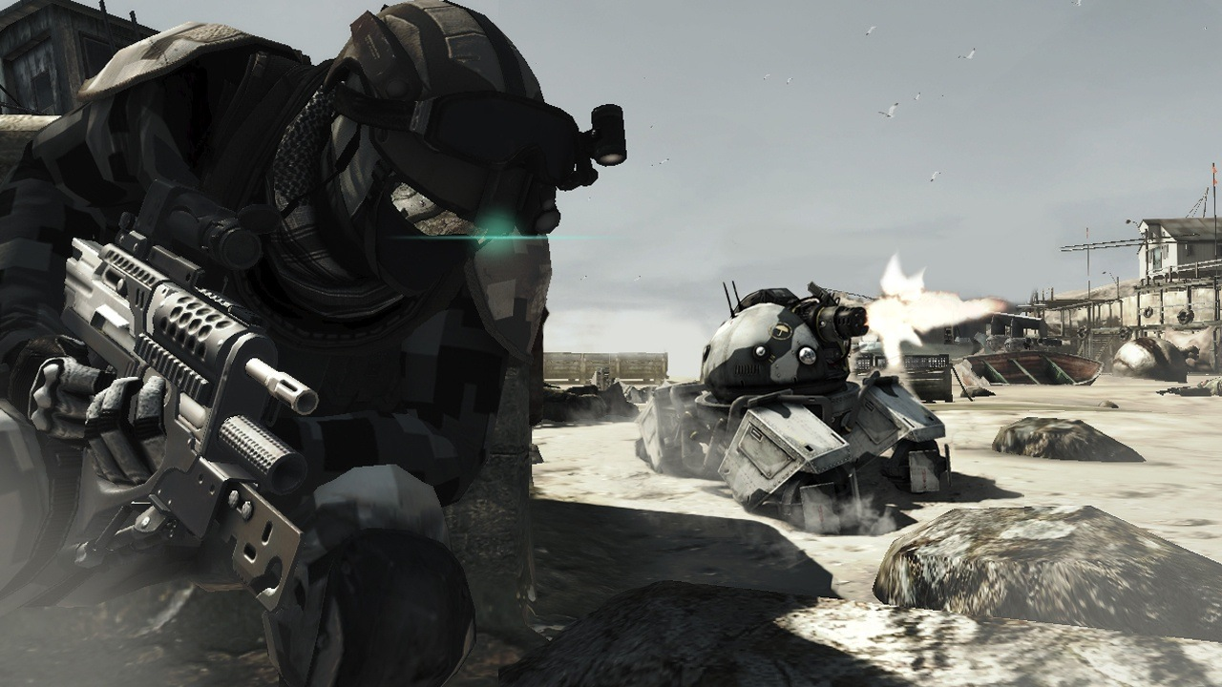
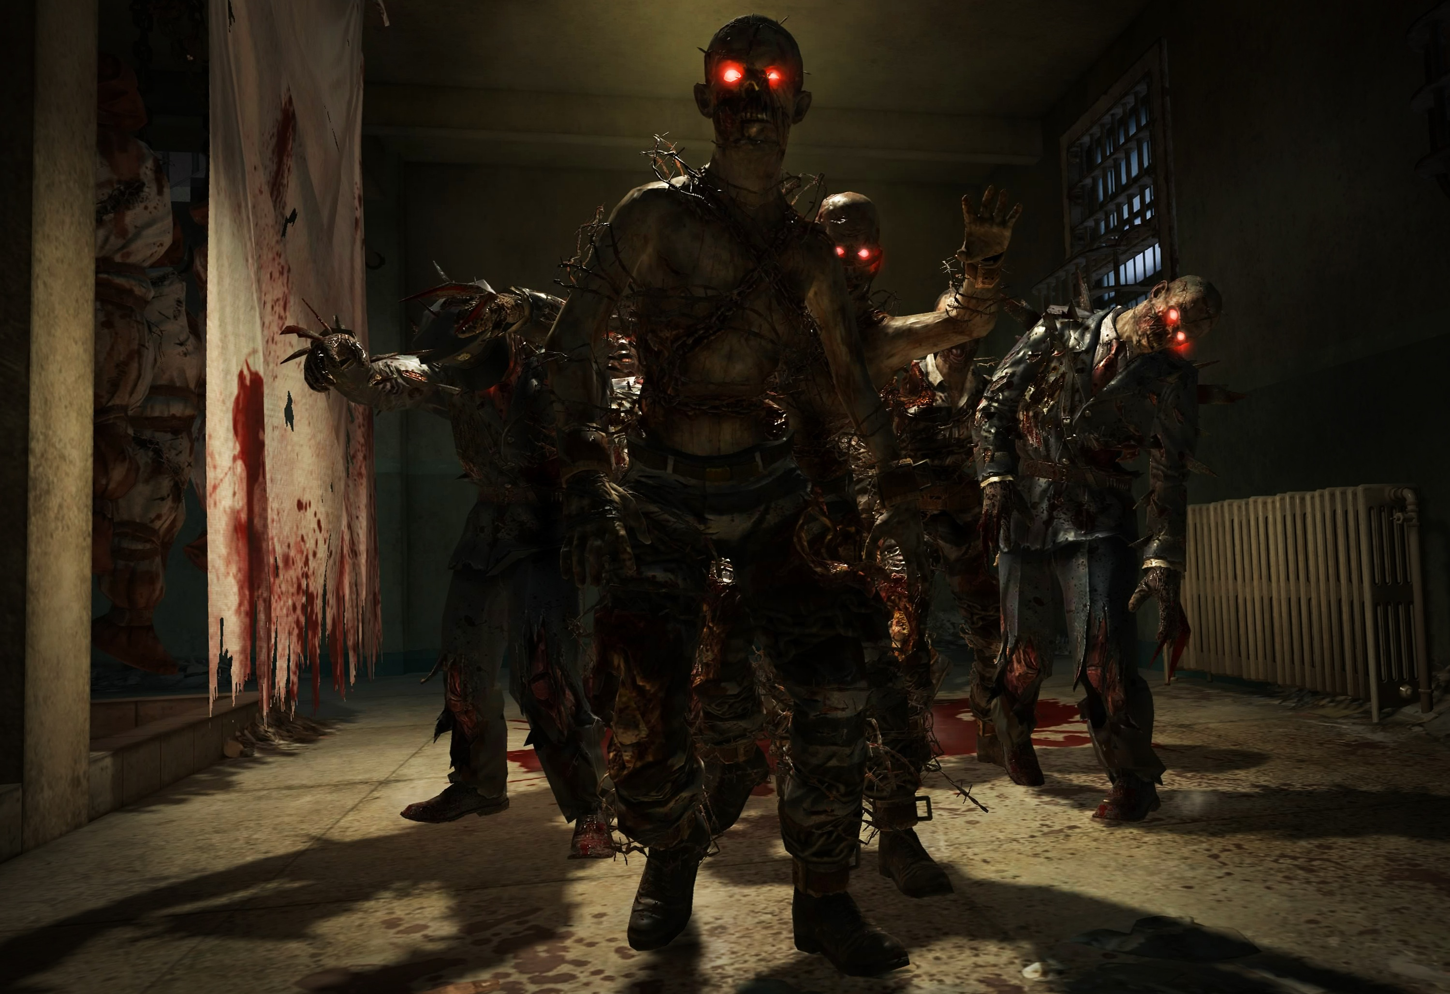
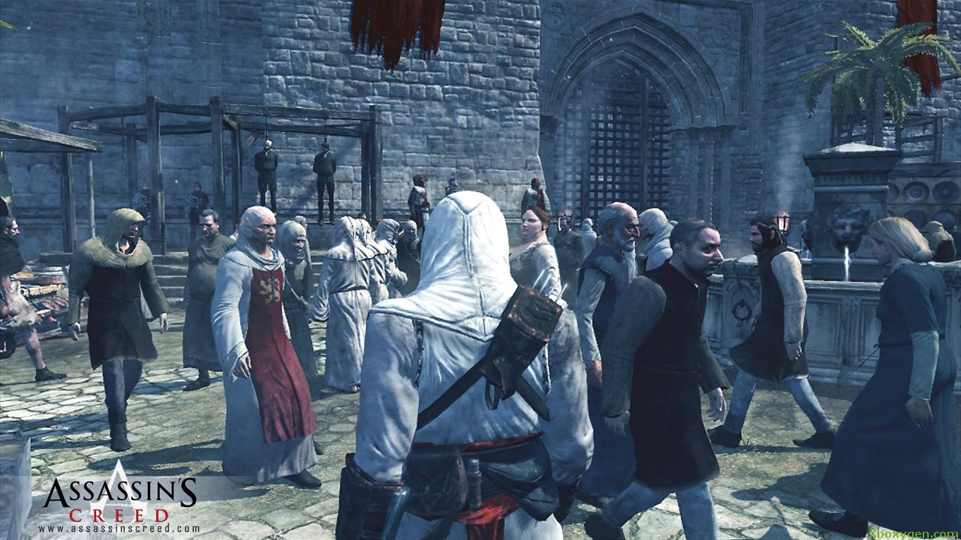
AI for Games
ICP2025 | ICP 3025 | ICP4152
Lecture 2 : The Role of the AI

Slide 2

Reminder
You are free to use assets you find online
Unity Asset Store
Unreal Asset Store
Turbo Squid (3D Models)
CGTrader (3D Models)
Tutorials, Examples
Just make sure you reference everything on your blog!

Slide 3
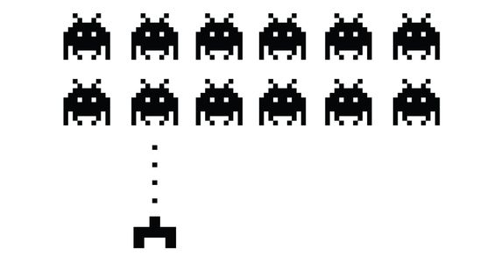
Lectures
Week 1 : Introduction
Week 2 : Role of the AI <- we are here
Week 3 : Reactive Agents Part I
Week 4 : Reactive Agents Part II
Week 5 : Navigation and Search
Week 6 : Artificial Stupidity
Week 7 : Learning and Evolution
Week 8 : Procedural Animation
Week 9 : New Technologies
Week 10 : Assignment / Exam Revision
Week 11 : Assignment Marking / Exam Revision
Week 12 : Assignment Marking / Exam Revision

Slide 4
Talking Point
What roles do AI play in modern video games?

Slide 5
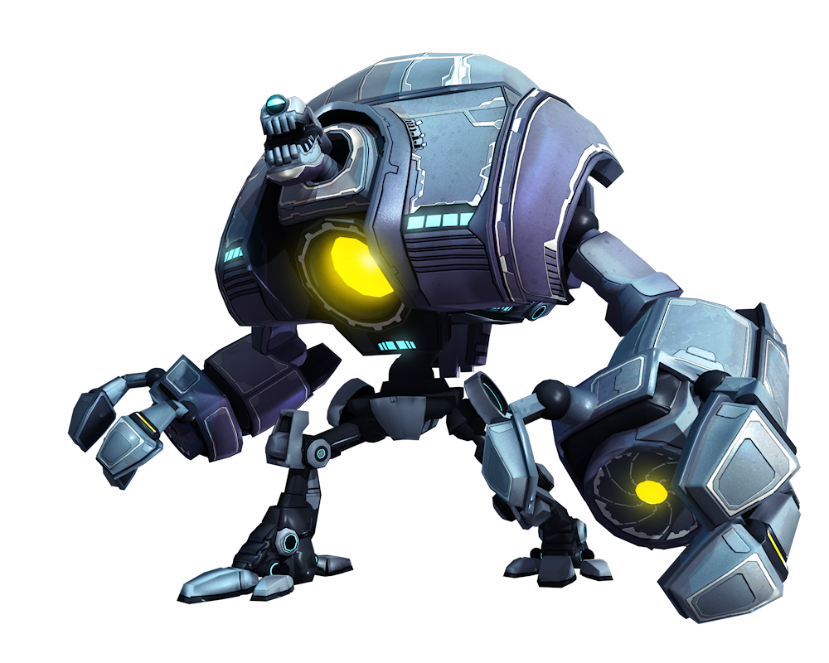
Today’s Lecture
The AI as an Opponent
The AI as a Team Mate
The AI as a Director
The AI as Scenery
The AI as Architect

Slide 6
AI as Opponent

Slide 7
Why do we need opponents?
Some games are simply puzzles where the player challenges themselves
However, most traditional games require a user to compete against an opponent
In some multiplayer games we also cannot guarantee that another human player will be available all the time
There is also an argument that an AI opponent may be preferable to a human one, as they will be consistent, numerous and with tuneable difficulty to suit the player

Slide 8
Talking Point
What makes a good AI opponent?

Slide 9
It depends on the type of game you are playing…

Slide 10
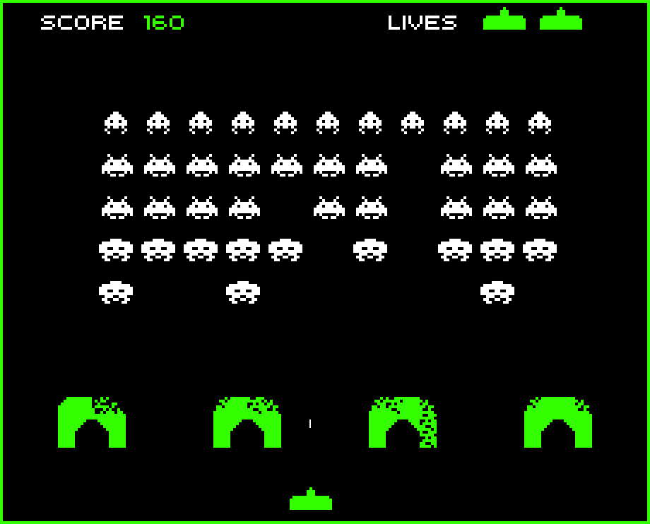

Slide 11
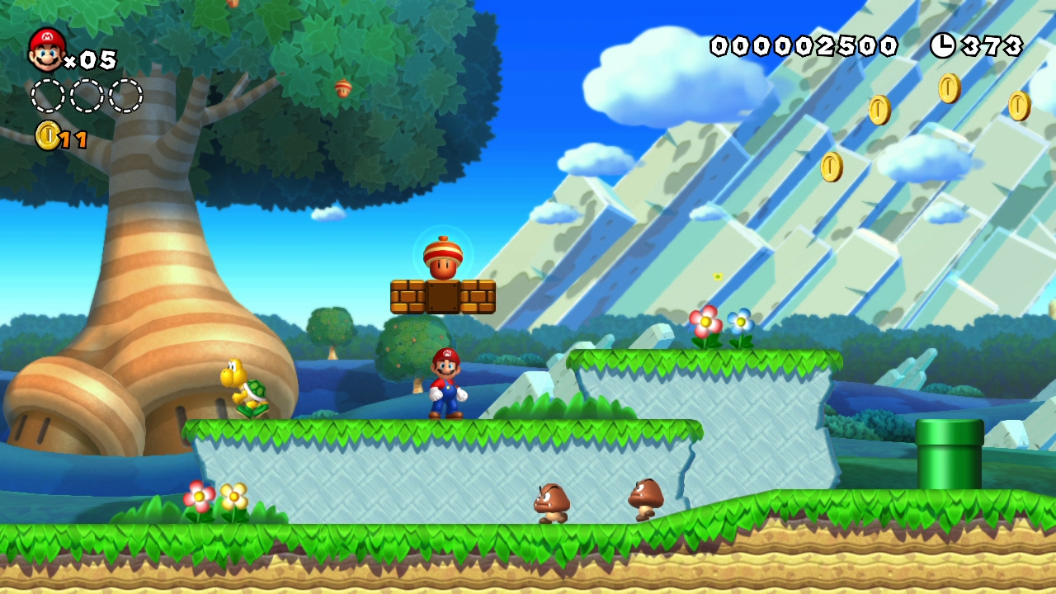
New Super Mario Brothers

Slide 12
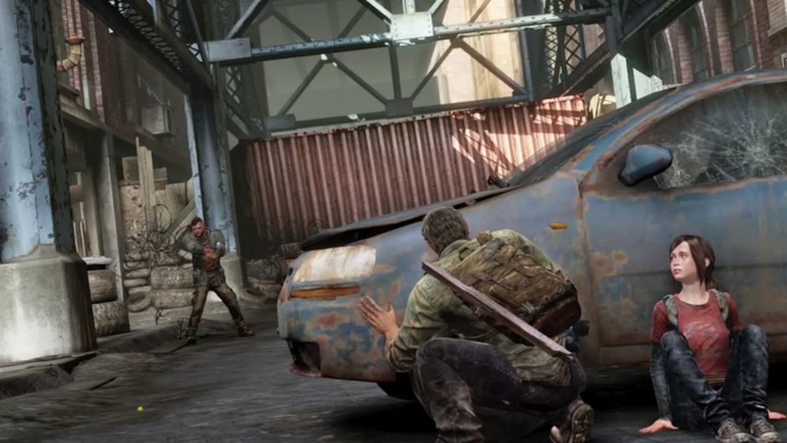
The Last of Us

Slide 13
Forza 6

Slide 14

Fifa

Slide 15
Halo 5

Slide 16
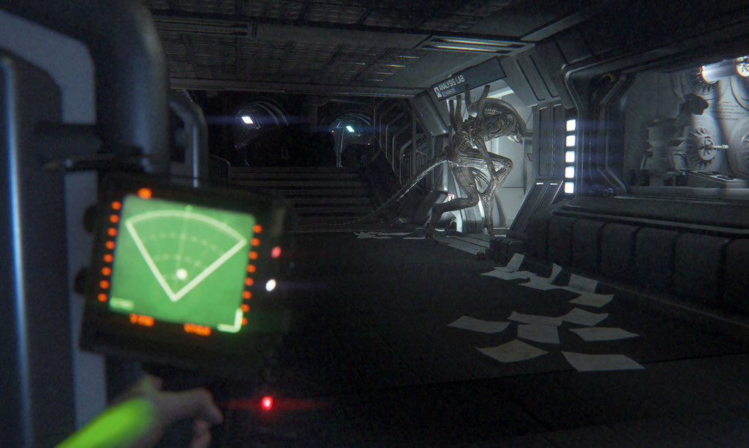
Alien Isolation

Slide 17
For example
Racing Game
Ability to pick a competitive racing line (or not)
Able to identify overtaking opportunities (or not)
Distinctive driving personality (aggressive, heavy-footed, late breaking etc.)
First Person Shooter
Moves in a realistic fashion
Believable as a enemy combatant
Tactical, able to hunt and demonstrate a “survival instinct”

Slide 18
Type of Opponent
Player Opponent
An AI opponent which obeys the same rules as you.
Consider the character a vehicle, like a car. It is simply driven by either the AI or a human, but both have the same controls, pedals, gears and steering wheel.
Basic example: Other player in Pong
Computer Opponent
Opponents which play by very different rules
May be omnipotent, and given significantly more information than the player
May follow very different objectives
Basic Example : Aliens in Space Invaders

Slide 19
Interaction
Ultimately the role of the opponent is to interact with the player
Interaction can have many forms
Movement
Behaviours
Tactics
Sound
Actions
Body language
Taunts
Infighting

Slide 20
Algorithms
Opponent AI is one of the most heavily researched areas of games
We will discuss many of the algorithms in future lectures
You will also implement several in your assignment
However the approach you take will depend entirely on the type of opponent you wish to create, which will vary based on factors like:
Game Type
Difficulty
Personality
Story
Role
Situation

Slide 21
AI as Team Mate

Slide 22
If we are to develop an AI team mate for a game we should first agree on a definition and establish what we believe a team-mate to be….

Slide 23
What is an AI team mate?
A character who takes into account the behaviour, state, needs, goals, plans, or intentions of players on the same team and makes coordinated decisions as part of the team. A character who prioritises participation.
A character who follows its own rules with the intention of achieving the same objectives as the player, and will attempt to optimise their behaviour towards achieving the game objectives.

Slide 24

Team Mate Interaction
There have been several studies which have demonstrated that the social rules that influence human to human interactions may also guide human to computer relations
It has also been shown that typically, humans prefer to play with a human team-mate. In one study (Merritt 2011), players was given a choice between two identical AI team-mates, but were told that one was human and the other was an AI. The player overwhelmingly (70%) chose the perceived human team-mate over the AI choice.

Slide 25
Team Mate Interaction (Paper References)
Merritt, T., McGee, K., Chuah, T. L., Ong, C. 2011. Choosing human team-mates: perceived identity as a moderator of player preference and enjoyment. In the proceedings of the 2011 Foundations of Digital Games Conference (FDG2011). June 28-July 1, 2011.
Tim R. Merritt, Kian B. Tan, Christopher Ong, Aswin Thomas, Teong L. Chuah, Kevin McGee. Are artificial team-mates scapegoats in computer games? In Proceedings of the ACM 2011 conference on Computer supported cooperative work (CSCW2011), March 19-23, 2011. pp. 685-688.

Slide 26
Talking Point
Where could we use an AI team mate?

Slide 27
Example Team Mate roles
Sport games – We often only take control of a single character at a time. The other characters are controlled by the AI until you take them over.
First Person Shooter (FPS) – Many games involve the player in a squad scenario. The other members of the squad will typically be AI players (though not always)
Companion – Related to above, a companion character accompanies you throughout the game (examples : The Last of Us, Bioshock Infinite).

Slide 28
Talking Point
What are the advantages and disadvantages of AI team mates?

Slide 29
AI Team Mates
Advantages
Provide support to the player
Act as a “bot” when human players aren’t available
Helps immerse and ground player
Provides exposition (story)
Reacts intelligently to player actions
Disadvantages
Annoy player
Get in the way, burden player
Repeat themselves
Behave unrealistically or worse
Difficult to balance
The main difference between good and bad AI team mates is how they are programmed - advantages can turn into disadvantages and vice-versa

Slide 30
Case Study – The Last of Us
The Last of Us by Naughty Dog (2013) has one of the best examples of companion AI in video games
Player shares adventure with an AI companion called Ellie
Ellie follows you around, talks to you, reacts to your actions and the environment, distracts enemies etc.

Slide 31
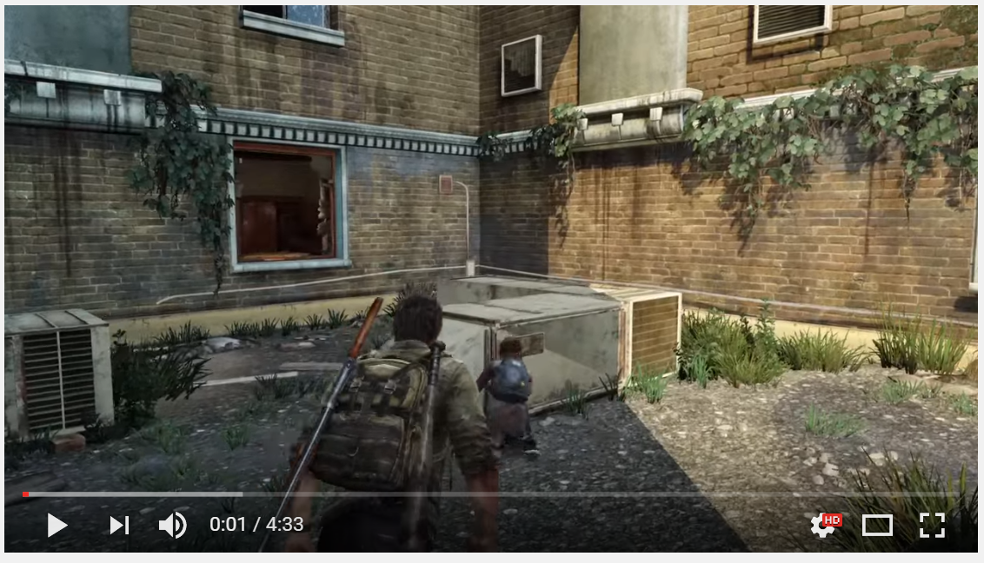
The Last of Us (video)
https://www.youtube.com/watch?v=F4AGHYTqMu0

Slide 32
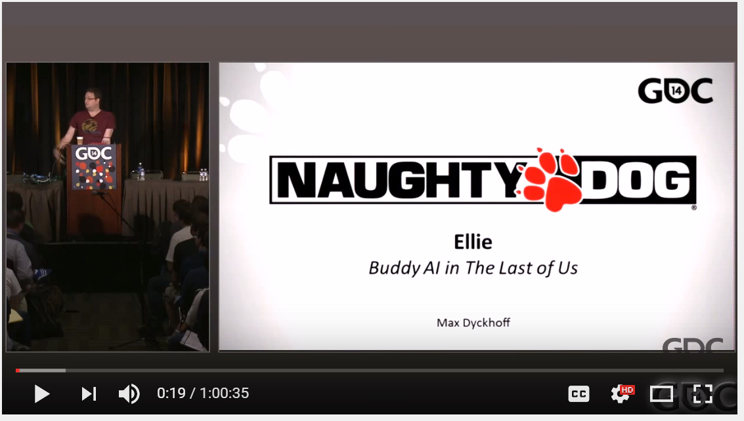
The Last of Us
Fantastic and accessible talk by Naughty Dog AI programmer Max Dyckhoff about how they created Ellie
Highly recommended watch if you want more information on what goes into a modern video game AI companion
https://www.youtube.com/watch?v=dnGzEn6swqo

Slide 33
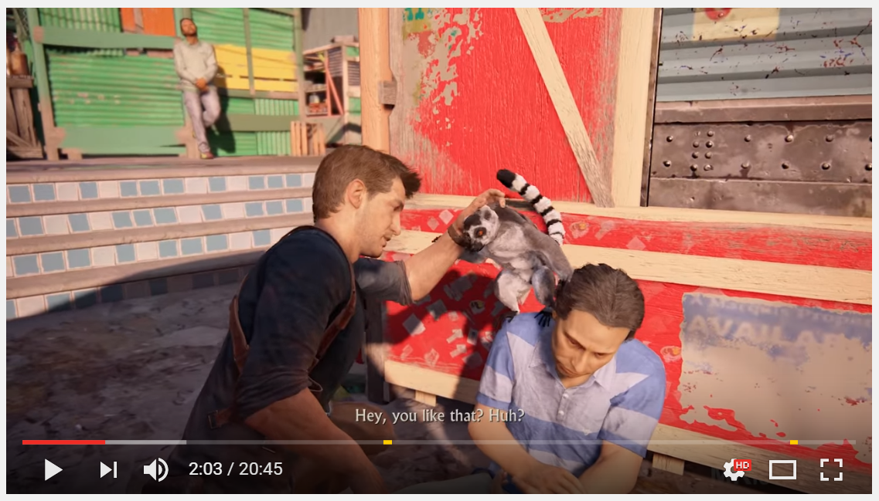
Uncharted 4 Companion AI video
Another example of great companion AI from Uncharted 4 (Naughty Dog, 2016) – skip to 2:00 minutes
https://www.youtube.com/watch?v=4Iyb6fOMJI4

Slide 34
AI as Director

Slide 35
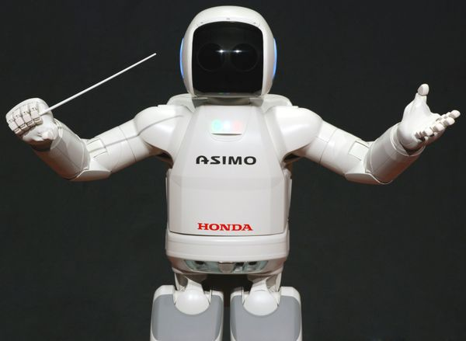
AI Director
An AI director is an algorithmic approach to replace randomness and manage the experience of the player

Slide 36

Left 4 Dead Case Study
Left 4 Dead (1 + 2) are four player 1st person shooter cooperative games developed by Turtle Rock Studios and Valve software.
Players progress through the game by moving from one safe house to another.
Waves of zombies and other monsters bar the way.
Challenges are presented long the way (find fuel, open doors, start generators etc)

Slide 37
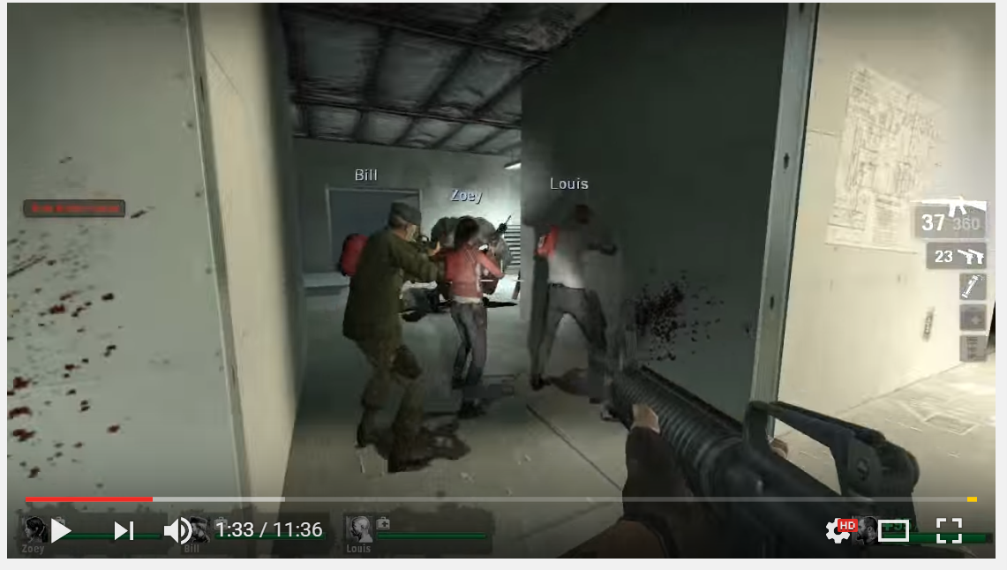
Left 4 Dead 2 video
https://www.youtube.com/watch?v=PNrFgQp00PE

Slide 38

Left 4 Dead Case Study
An excellent video overview of the AI Director’s role in Left 4 Dead can be seen in the YouTube video on the right
The whole series of videos is worth checking out if you’d like to know more
Hour+ Lecture on Left 4 Dead (link)
https://www.youtube.com/watch?v=WbHMxo11HcU

Slide 39


Slide 41
L4D’s AI director
In 2008 Valve released Left 4 Dead which took a novel approach to games AI in the form of a Director.
The Director, also known as the AI director (or AID) is an overarching artificial intelligence which controls the “game dramatics”, including the pace of each level.
Left 4 Dead remains probably the most well known example of AI directors in games.

Slide 42
Spawning
In traditional games, opponents are spawned at standard points, typically due to a varying random chance or a form of proximity metric.
In contrast, the AID places new enemies based on the factors such as the players skill, situation, or location, ensuring the player has a different experience each time they play the game.

Slide 43
Spawning
As well as spawning standard opponents, the AID also decides when to introduce more challenging opponents (known as the special infected), and inventory items (such as health packs or new weapons).
The intention is to build and reduce the game's intensity to keep the player engaged.
The director is also responsible for creating and relaxing tension through sensory cues such as adjusting the background music.

Slide 44
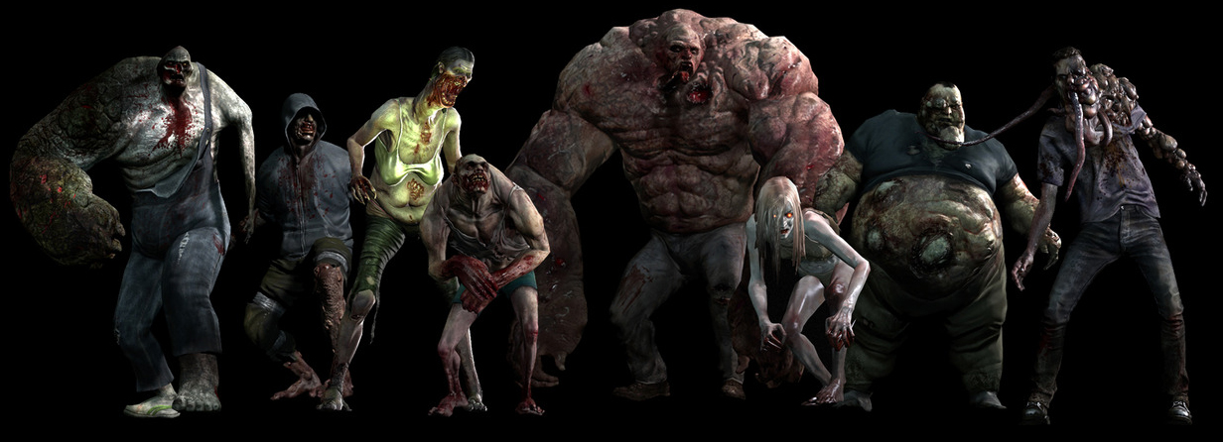
One of the roles of the AID is to introduce (spawn) Challenging Opponents (Special Infected, above) into the game at times to raise tension

Slide 45
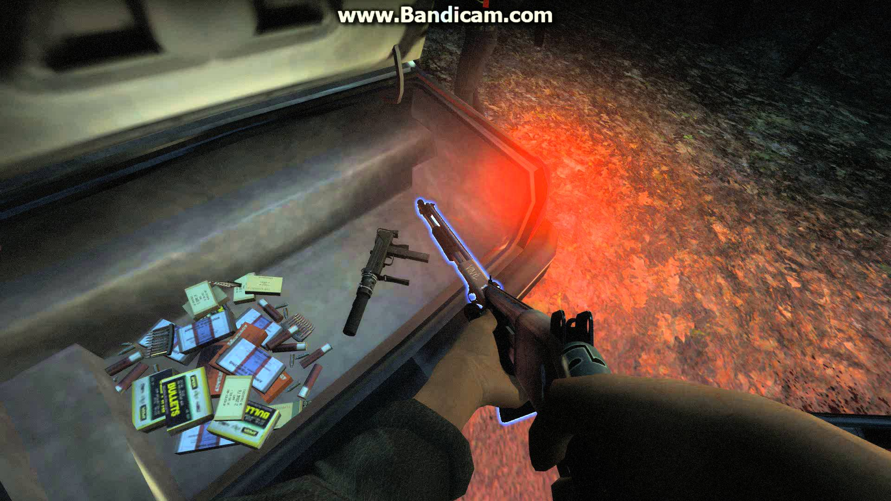
Another role of the AID is to introduce health, ammo and weapons into the game to lower tension and give players the upper hand

Slide 46
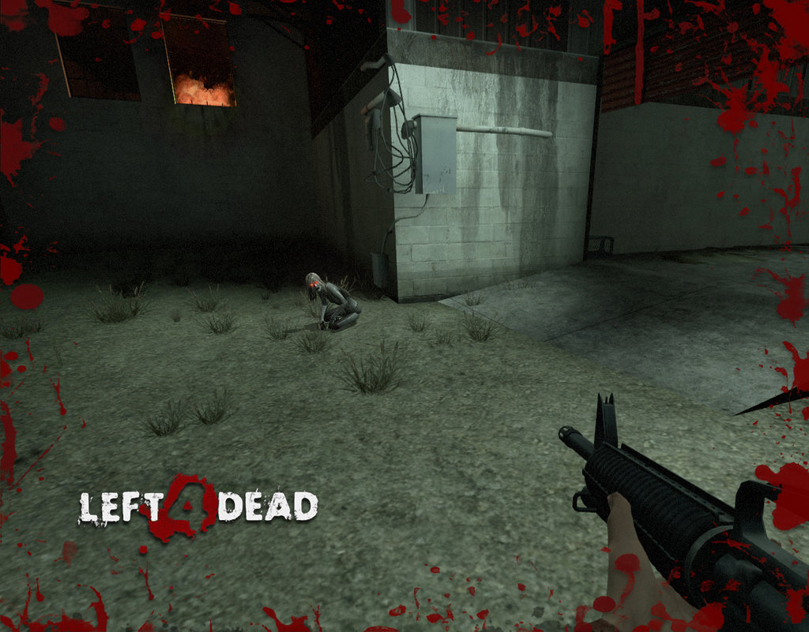
Spawning example - Witch
The Witch is one of the most feared opponents in L4D
She will spawn into the game sitting on the floor + sobbing
Players have to move very slowly and quietly past to avoid “activating” her
Activating the Witch is a bad idea as she is very fast and deadly

Slide 47

Spawning example - Witch
The AID will make sure that the Witch spawns in a quiet area of the map
It will rarely spawn zombies or other infected near the Witch as this would cause chaos and be “unfair”
The Witch therefore represents an opportunity to include a different type of atmosphere and pacing to a level – quiet and tense

Slide 48
Replayability
One of the principle objectives of the AI director is to promote replayability – essentially keeping the game interesting (and profitable!) even after the player has “completed” the game
There are many games, such as Counter Strike, Team Fortress 2, Destiny, Overwatch, L4D2 etc. that despite their limited content have thriving online communities playing for thousands of hours
One of the roles of the AI director is to replicate this repayable quality

Slide 49
Replayability
The argument is that human players are particularly good at recognising patterns, and memorizing static “spawn points” allowing them to remember and rehearse a strategy.
This results in an optimum tactic which a player can follow each time, and the exploitation of quirks in the scenery, such as locations where a player can shoot but not be shot (a practice commonly known as “glitching”).
There is also an argument that static spawn points reduce player cooperation, as each will have learnt their own optimum tactic.

Slide 50
Structured Unpredictability
One approach to overcome these problems is through “Structured Unpredictability”, a concept promoted by Valve.
Structured unpredictability is described as being neither totally random, nor deterministically uniform
It involves creating the illusion of random encounters while still keeping the game within predefined parameters, ensuring it is neither too intense or dull

Slide 51
Placement Shuffling
A more simplified approach to NPC placement typically used with challenging boss (“special infected”) opponents.
Divide the length of the path that the player must travel (from start to end) by the number of engagement events (combat) you wish the player to have.
This new value represents a spawn location (+ or - a random range) along the route.
Take a number of opponent types you wish to spawn and a null type, where nothing will be spawned, shuffle and deal, reshuffling if a repeat is dealt.

Slide 52
Four Stages of Gameplay
Build-up: A full-threat population is generated and increased until the survivors max emotional intensity has been reached.
Sustain: The threat is sustained for a number of seconds after the the threshold has been achieved.
Fade: Switch to a minimal threat population, and maintain until intensity has reduced out of peak range. This phase allows the current combat engagement to conclude without using all of the time allocated to the relax period.
Relax: Maintain a minimal threat population for a set time period, or until the survivors have reached a specific location.

Slide 53
Dynamic Game Pacing (DGP)
During the development of L4D the design team was inspired by player vs player gameplay, specifically within Counterstrike
They noted that the natural gameplay was spiky, where quiet tension would be punctuated by intense combat
They noted that while long periods of inactivity could bore the player, uninterrupted combat was fatiguing
However, unpredictable spikes in the intensity of the game kept things interesting, and ensured the player had a different experience each time (despite it often taking place on the same map)

Slide 54
DGP Algorithm
Estimate the emotional intensity of each player
Track the max intensity of each player
If intensity exceeds the max intensity, remove threats
Otherwise create an “interesting” population of threats

Slide 55
Talking Point
How would we track the “emotional intensity” of a player’s experience?

Slide 56
Tracking Players
How erratic are they looking around?
Are they firing their weapon erratically?
How much health have they gained or lost in the last x minutes?
How many zombies have they killed in the last x minutes?
How close did the average zombie get?

Slide 57
Talking Point
What other parts of a game could be controlled by a director?

Slide 58
AI as Scenery

Slide 59
Scenery
Relationships are not a simple binary, characters that you meet in real life don't just fall into the categories of friend or foe.
In fact, the majority of people you will encounter in the real world will simply be passers-by living a life of little to no connection with yours.
This is the third role of the AI, to add additional characters to the environment to make the gameplay more realistic or immersive.

Slide 60
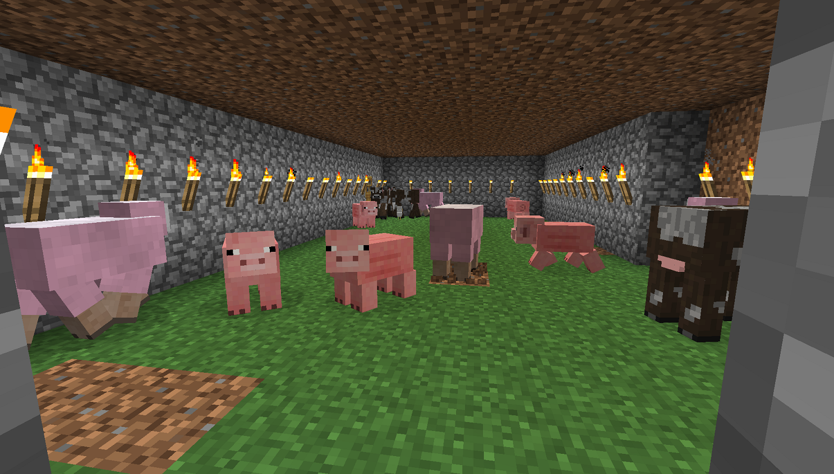
Animals
While we may consider animals intelligent, we don’t expect them to provide cognitive responses to the player… so the AI may be considerably simpler.
The players actions may have very little influence on a virtual creature. They may simply go about their own objectives.
An AI animals role may change from scenery to advisory based on the player. Many games now incorporate a hunting mode (Red Dead Redemption, Far Cry etc)

Slide 61

Flocks, Packs and Herds
For realism some animals may move in groups, and requires a slightly more sophisticated AI which allows them to move and behave as a group.
One approach to this is the BOIDS algorithm designed by Reynolds which utilises a combination of Steering Behaviours to influence the characters which we will cover in a future lecture.

Slide 62
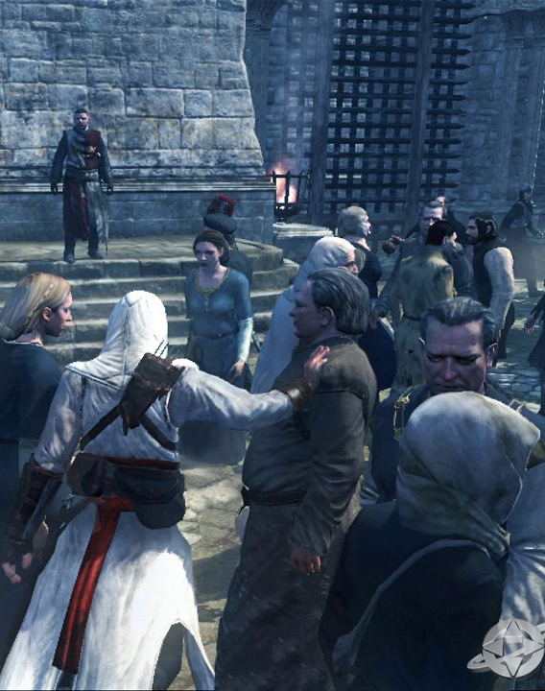
Crowds and Extras
In Assassins Creed the AI crowds facilitate gameplay, as an assassin you can use groups of people to hide, or cause commotion by throwing money on the ground.
The GTA series also makes extensive use of NPC extras, whole Cities full of NPCs, driving around, going about their daily lives, firemen, thieves, police etc. The NPCs in GTA can also turn into opponents.
Pro Evolution Soccer 2015 has an AI crowd system which cheers based on the current game context. If players are doing well, the crowd cheers more and vice versa.

Slide 63
Talking Point
Does a member of an AI crowd need to be as complex as an opponent or a team-mate NPC?

Slide 64
AI as Architect

Slide 65
Talking Point
Why would getting the AI to create content be advantageous?

Slide 66
Procedural Generation
Procedural generation is an approach where content is generated algorithmically rather than by a human designer.
This allows an AI to create environments that the player interacts with.
Particularly useful in open-world or sandbox games where it would be impossible or not economically viable to design the environment manually.
Saves storage or main memory (“infinite worlds”).

Slide 67
History of procedural level generation
Level generation was a feature even in many early games
CPU and Memory was limited - This lead early games to use random generation as a trade-off.
A different random seed each time the game was played would produce a different experience for the player.
However, some of those experiences may not be any good!

Slide 68
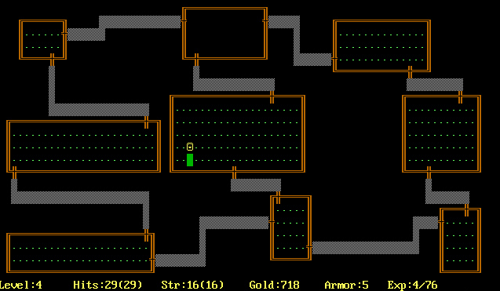
Early example : Rogue
Rogue (1983) was one of the first examples of RPG dungeon-crawler games.
The design of each dungeon and the placement of the monsters were all managed with procedural content generation
Namesake of the popular “Rogue-like” genre of video games

Slide 69
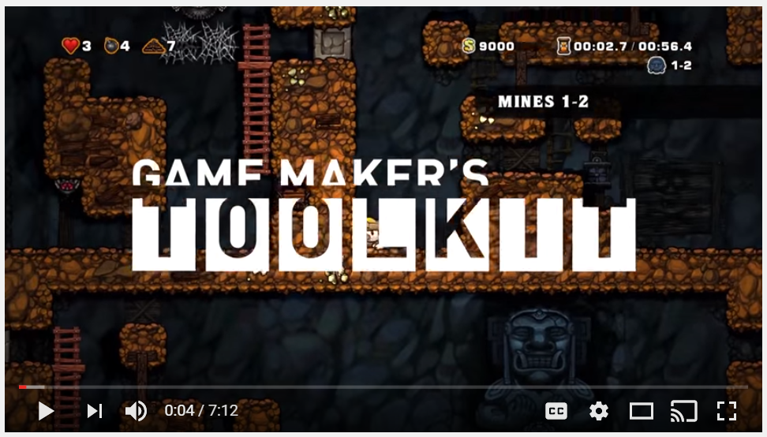

Spelunky
The seminal video game Spelunky uses several techniques to procedurally generate endlessly interesting levels
This excellent YouTube video provides an overview of how levels are generated
See also the book Spelunky by Derek Yu, 2016 (link)
https://www.youtube.com/watch?v=Uqk5Zf0tw3o

Slide 70
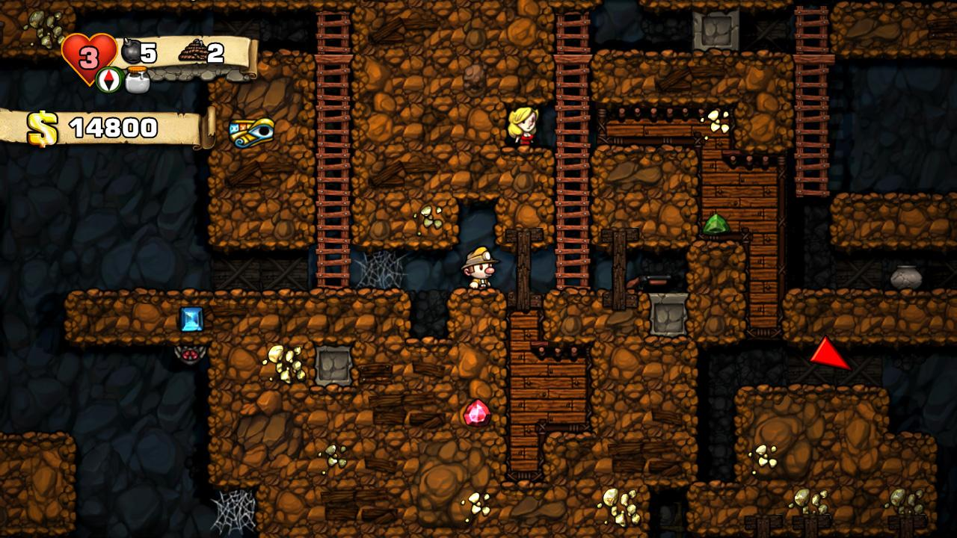
Spelunky screenshot

Slide 71

Minecraft
The environments in Minecraft are generated using procedural generation algorithms
3D Engine is “voxel” based, rather than polygonal
Produces the terrain, water, caves, plants, wildlife

Slide 72
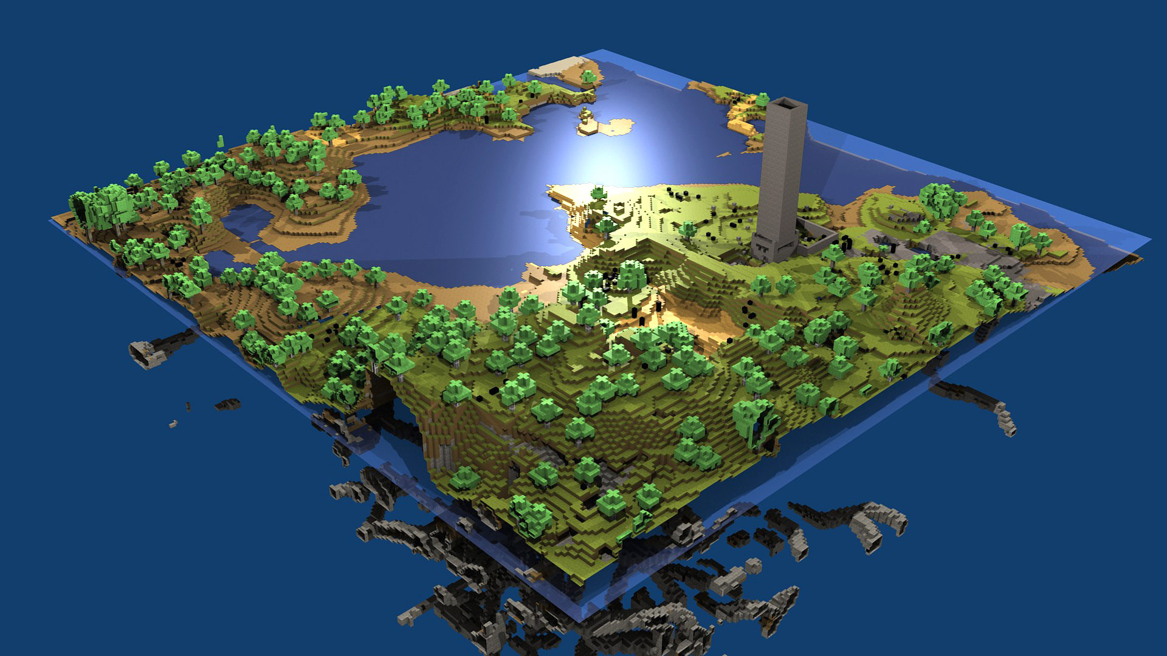
Minecraft screenshot

Slide 73
Desirable Qualities of Procedural Generation
Enough novelty to keep the player interested
Length of level
Balanced difficulty
Adapted to the players preferences
Reliable, high quality environment
No dead ends or errors
For a great overview of desirable qualities in level generation download this paper. This could be useful background reading for anyone considering having an AI architect in their game:
Shaker, Noor, et al. "The 2010 Mario AI championship: Level generation track." Computational Intelligence and AI in Games, IEEE Transactions on 3.4 (2011): 332-347.

Slide 74
Risks
Generating content can become a complex problem, taking substantial time to complete.
Complete testing of procedurally generated content is impossible (you can only statistically sample)
If even 1/100 levels generated are “bad”, that’s a problem
Procedurally generated levels can be viewed as meaningless content
Soulless without the guiding hand of a human designer

Slide 75
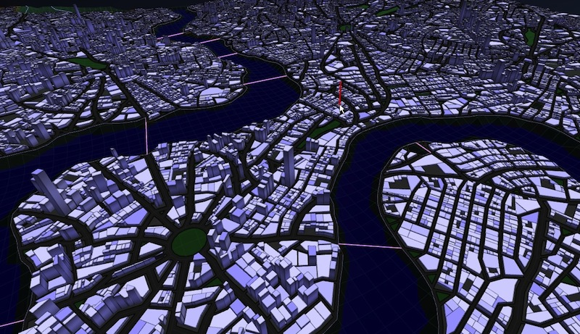
Current challenges in procedural generation
Ensure quality of player experience
Mental and statistical model of players
Environments make sense (i.e. underlying rules of generation)
Detecting, avoiding and dealing with broken levels
“Deep understanding” vs “generate and test”
Procedural City Generator from Introversion

Slide 76
Current challenges in procedural generation
Destiny – It’s easy to have infinite levels, but are they fun? Is there a sense of progression and achievement?
How do you know you are generating something interesting?
Social factors and full expressiveness with story / language generation
Personalised generation of content

Slide 77
When is procedural content generation (PCG) a good idea?
The chart on the right is for developing a level using PCG techniques (grey) vs designing a level manually (red)
For small environments, designing them manually will take much less time, but as the size increases so does the time it takes
A PCG level designer takes a fixed amount of time to develop and (in principle) is not affected by the size of the environment.
So for generating large environments, it could make a significant time and cost saving

Slide 78


Slide 79
No Man’s Sky
The video game No Man‘s Sky by Hello Games attemped to procedurally generate and entire Universe
18,446,744,073,709,551,616 unique planets
That would take 5 billion years to explore…
Terrain, animals, plants are all procedurally generated
How to ensure that the planets being generated are fun and interesting enough to explore?

Slide 81
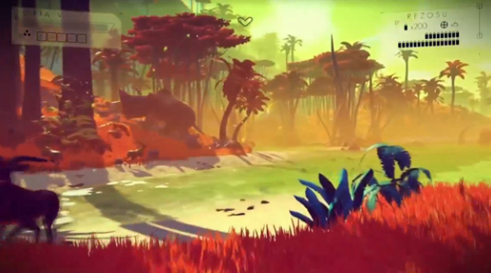

Slide 82
Talking Point
How would you test an algorithm as big as this?

Slide 83

Automated Surveying
The developers behind No Man’s Sky created virtual autonomous drones that fly around each procedural planet, taking photos and surveying the terrain
Developers could then quickly get an idea about each planet, and adjust the underlying algorithms appropriately

Slide 84
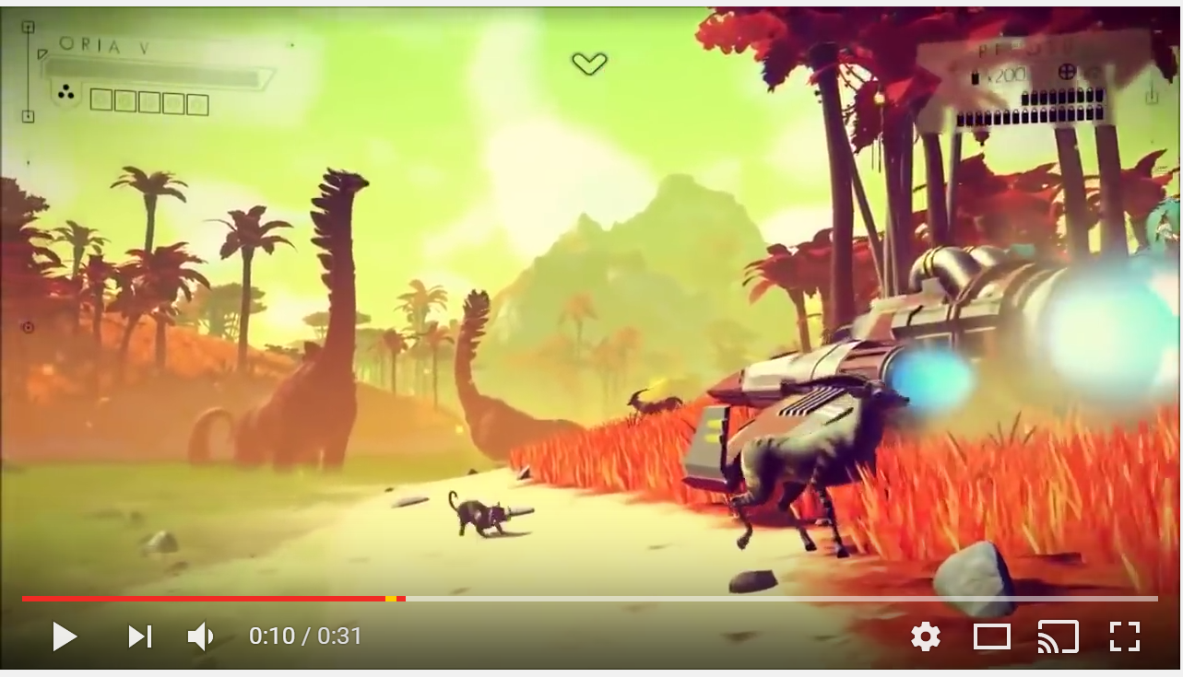
No Man’s Sky, Expectations vs Reality
https://www.youtube.com/watch?v=4KxRp8jeliQ

Slide 85

Lessons from No Man’s Sky
No Man’s Sky was released in Summer 2016
Most people found the game fun for a few hours, but after that you started to notice repetition
Difference between player expectation and actual experience resulted in massive controversy
Hello Games, the UK company behind No Man’s Sky, were under investigation by advertising standards
However the procedural algorithms remain some of the best and most complex created for video games

Slide 86
Conclusion

Slide 87
Conclusion
AI is used for more than just the opponents in a game
The role of the AI may govern the game dynamics and will influence how the levels are designed
Each role the AI undertakes has its own unique challenges, and problems to overcome
Next week we will start looking at AI algorithms and techniques…

Slide 88




Lab Week 2
Your goals for this week:
Continue developing your game
Remember to write a blog post!
If you are unsure about what to make, or your game idea, please ask us in the lab for advice

